Slide 1
Strategies for Presenting Results
Saturday June 4, 8:30-10:00am
Kristin Rankin, PhD
Research Assistant Professor
      Division of Epidemiology and Biostatistics
      University of IL School of Public Health
Training Course in MCH Epidemiology

Slide 2
Presentation of Data
Tables, charts and graphs provide an effective method for communicating person, place, and time data to your audience
The organization and format of these tables, charts and graphs may differ depending on your goal and the type of results displayed (ie descriptive statistics, measures of effect, results of multivariable methods, etc)

Slide 3
Presenting Data Visually
1. Start with the message/content you are trying to convey and identify the data that will be used
2. Consider your audience
  General Public
  Stakeholders
  Scientific Community
3. Consider the form of the data
  Prevalence estimates (“row percents”)
  Distributions (“column percents”)
  Measures of effect (conveying significance)

Slide 4
Presenting Data Visually
4. Determine if a table, chart (what type?), or both are needed to communicate the message
5. Determine where to display each variable
6. Determine the best design for the remaining objects
7. Determine if particular data should be featured, and if so, how
Modified from Stephen Few’s Whitepaper “Communicating Numbers” http://www.perceptualedge.com/articles/Whitepapers/Communicating_Numbers.pdf

Slide 5
Presenting Data Visually
Tables: Convey large amount of data in systematic way
Effective tables include:
Table number and title that clearly identifies the data displayed
Column and row headings
Decimal alignment
Expanded forms of abbreviations used in the tables, generally as footnotes
Additional explanatory footnotes as needed
“Guidelines for Conducting Birth Defects Surveillance: Chapter 11 -Data Presentation”: http://www.nbdpn.org/docs/Ch11_DataPresentation.pdf

Slide 6
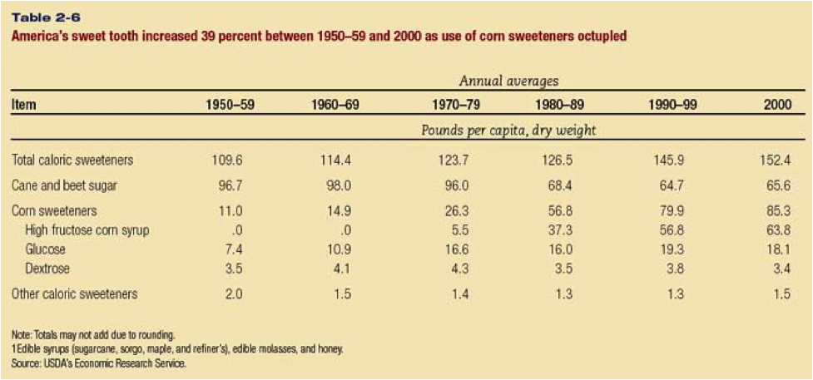
Effective Tables
Also see handout on cancer survival rate tables

Slide 7
Presenting Data Visually
Charts: Summarize data and highlight main points for audience
  Line Charts:
    Trend
    Continuous variables
    Survival Data
  Bar Charts (vertical and horizontal):
    Trend
    Prevalence data for discrete groups
    Distributions/Proportions (100% stacked bars)
  Pie Charts:
    Distributions/Proportions
    Population Attributable Fractions (PAFs)

Slide 8
Line Chart Guidelines
Lines should only be used when variable is on an ordinal or continuous scale
Do not connect the points on a line if there are missing values in between existing data
Intervals should be equally sized
  Exception: Extreme outliers can be lumped at the lower or upper end (ie income)
Tick marks on the x-axis should accurately reflect the distance between the values
http://www.perceptualedge.com/articles/visual_business_intelligence/line_graphs_and_irregular_intervals.pdf

Slide 9
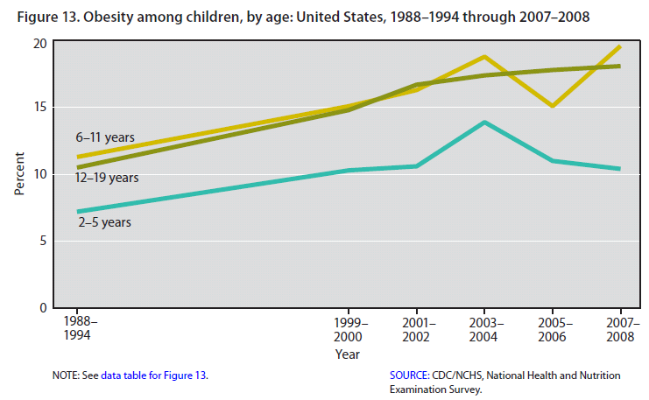
Line Chart - Trend
Inappropriate to connect points across years with no data!
From Health, United States, 2010: http://www.cdc.gov/nchs/data/hus/hus10.pdf#

Slide 10
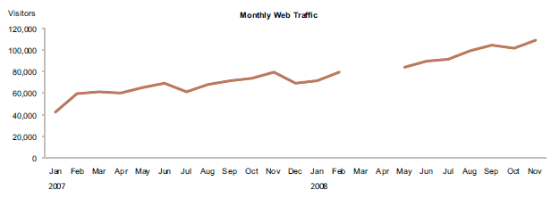
Line Chart with Missing Data
Omit the line altogether when
data are missing along the line

Slide 11
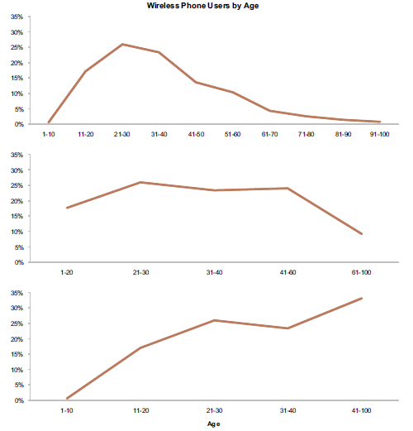
Which one is correctly displayed?

Slide 12
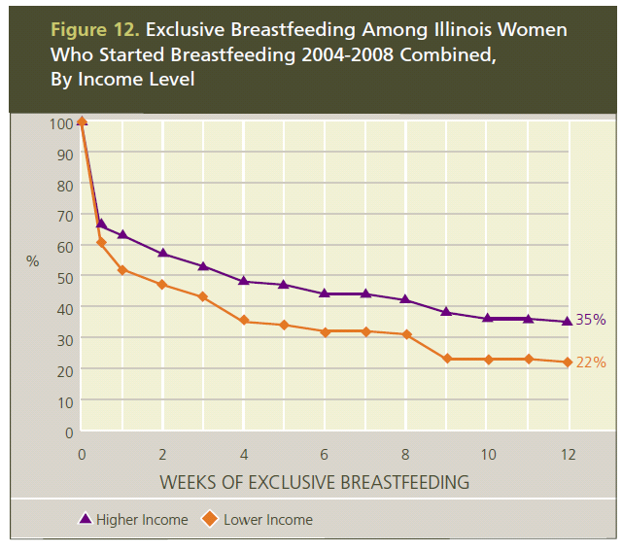
Effective Line Chart – “Survival” Data

Slide 13
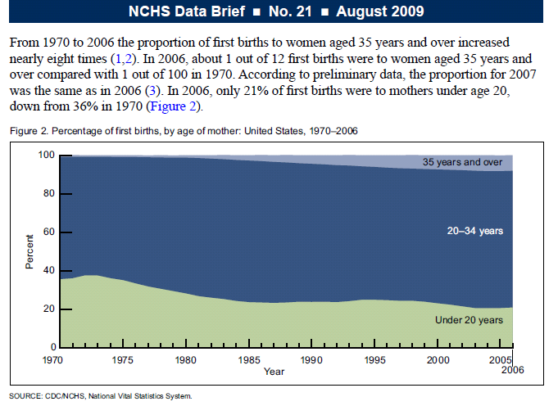
Line Chart – Distribution + Trend

Slide 14
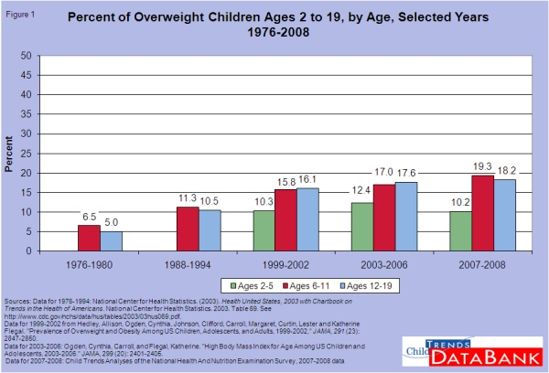
Vertical Bar Chart - Trend

Slide 15
Vertical Bar Chart - Prevalence
Source: NCHS 2003 Vital Statistics

Slide 16
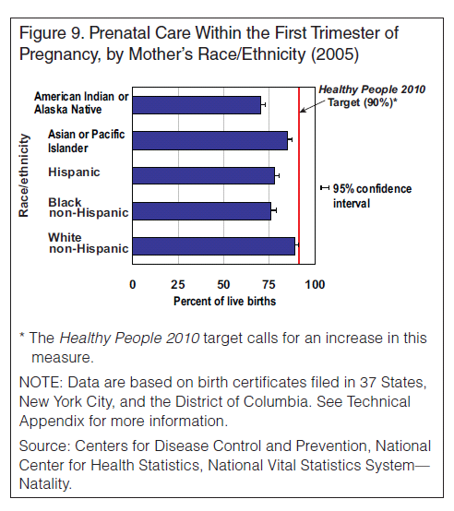
Horizontal Bar Chart - Prevalence
Use horizontal bar charts when text labels associated with bars are long or there are many bars to display

Slide 17
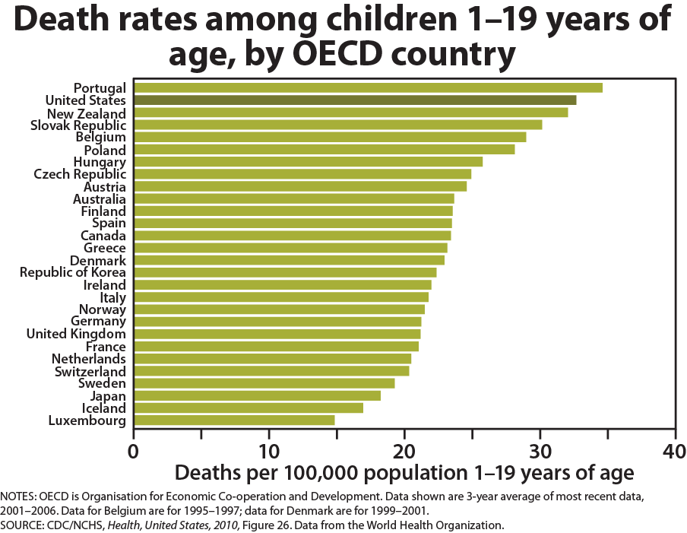
Horizontal Bar Chart - Rates

Slide 18
Stacked Bar Charts
  If possible, avoid using stacked bars, especially when the percentages don’t add to 100% - they make it difficult to compare across groups
  Sometimes 100% stacked bars make sense for comparing distributions, but:
      Only use with a small number of categories
      Display the data label in each portion of the bar

Slide 19
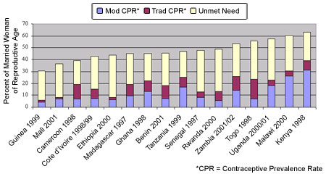
Ineffective Stacked Bar Chart
In Sub-Saharan Africa, there are High Levels of
Unmet Need for Contraception
Source: Demographic and Health Surveys
http://www.usaid.gov/our_work/global_health/pop/news/aidsday.html

Slide 20
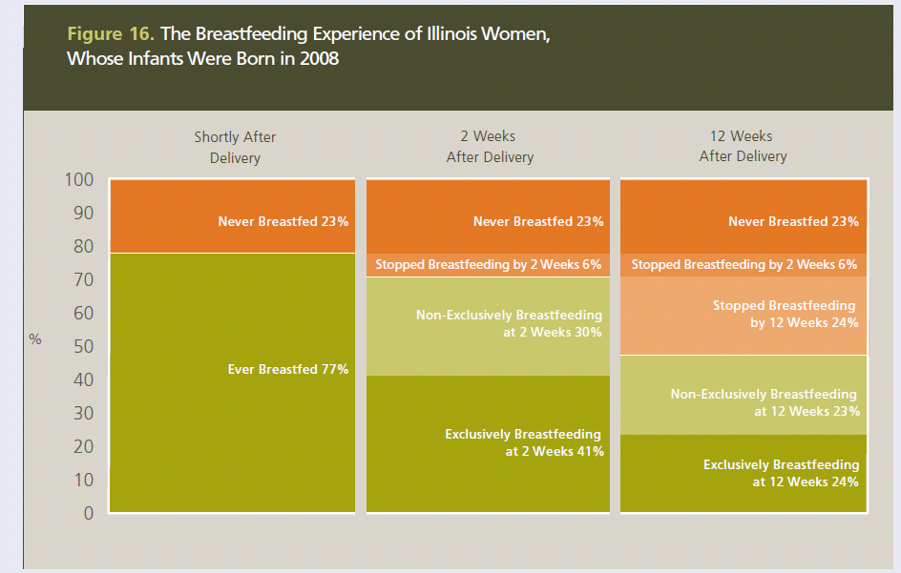
Effective 100% Stacked Bar Chart

Slide 21
Pie Charts
  In general, it is difficult to make comparisons effectively with pie charts, but they are sometimes useful for displaying the parts of a whole / distributions
  If using pies, keep the ordering and positioning of pie slices the same across pies when comparing multiple pies
  Order slices by magnitude when possible

Slide 22
Smoking and Quitting Behaviors During Pregnancy, State A 2005
Pie Chart Plus Vertical Bar - Distribution
Source: State A PRAMS Data 2005

Slide 23
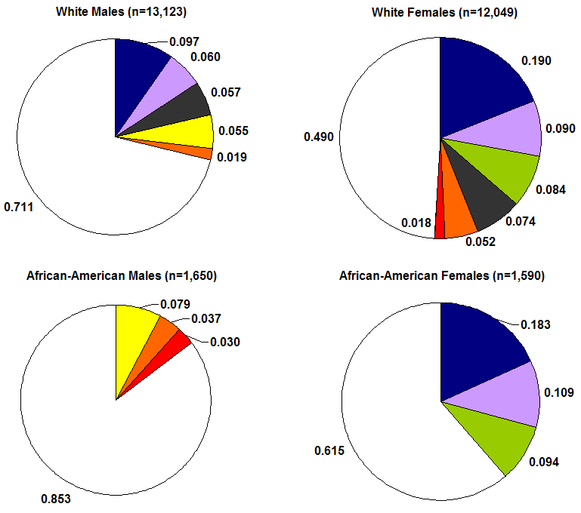
Pie Chart – Population Attributable Fractions
Average PAFs* For Modifiable Risk Factors for Overweight
Among White and African-American Male and Female Adolescents
*Controlling for unmodifiable factors: age, number of children and adults in the household, nativity, household education, poverty status, school type and urban/rural residence

Slide 24
Presenting Data Visually
Maps: Show geographic comparisons and
associations
  Descriptive
    Plotting locations of events as points on a map
    (dot-density maps)
    Displaying rates/prevalences for polygons (census tract, zip code, county, state, country) on a map (choropleth/thematic maps)
  Analytic
    Spatial relationships between exposures and health outcomes

Slide 25
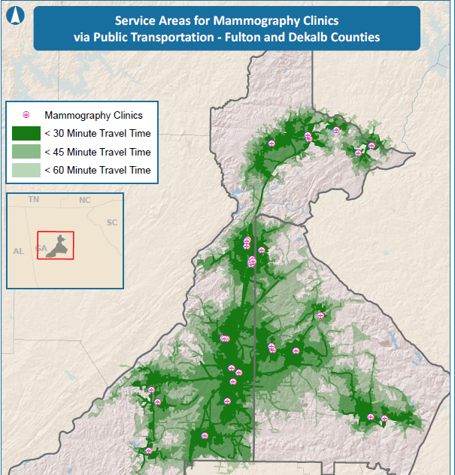
http://cehi.nicholas.duke.edu/gisexchange/mapgallery/maps/pdf/mammography_clinics.pdf

Slide 26
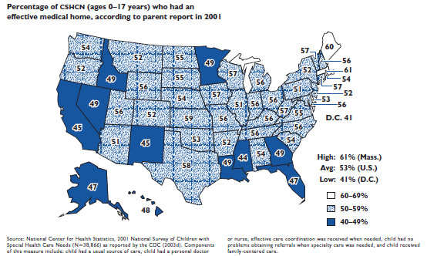
http://www.commonwealthfund.org/usr_doc/leatherman_pedchartbook_700.pdf

Slide 27
Analytic Design Principles
Comparisons
Causality, Mechanism, Structure, Explanation
Multivariate Analysis
Integration of evidence
Documentation
Content Counts Most of All
Edward Tufte, Beautiful Evidence, Cheshire Ct: Graphics Press, pp126-139

Slide 28
Principle 1: Comparisons
    Show appropriate comparisons,
    contrasts, differences
    Understand whether row percents or column percents more effectively make comparison
    Order bars/pie pieces in charts to show comparison of interest
    Display benchmarks or overall averages to provide a frame of reference when appropriat
    Highlight value of interest to be compared to others, using a darker color or outline

Slide 29
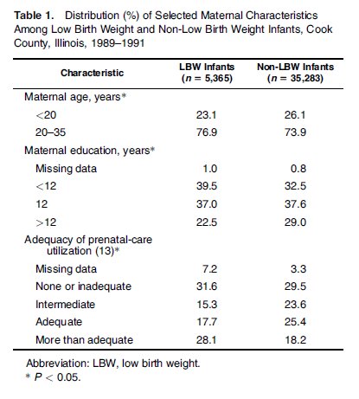
Column vs Row Percents in Tables
Table 1. LBW Rates by Selected Maternal Characteristics, Cook County, Illinois, 1989-1991
% LBW
(n=40,648)
11.9
13.7
16.0
15.6
13.0
10.5
24.9
14.0
9.0
9.6
19.0
From Collins, et al. (2009). Transgenerational Effect of Neighborhood Poverty on Low Birth Weight Among African Americans in Cook County, Illinois, AJE

Slide 30
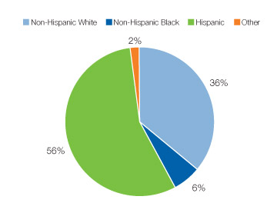
Column vs Row Percents in Charts
Proportions of Teen Births Among 15- to 19-Year-Olds by Race and Hispanic Ethnicity, Colorado, 2006
http://www.cdc.gov/TeenPregnancy/Colorado.htm

Slide 31
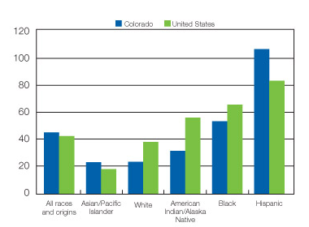
Column vs Row Percents in Charts
Birth Rates (live births) per 1,000 Women Aged 15–19 Years, by Race and Hispanic Ethnicity: Colorado and United States, 2006
http://www.cdc.gov/TeenPregnancy/Colorado.htm

Slide 32
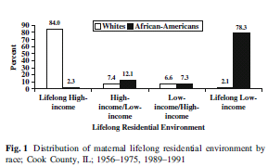
Ordering Bars to Show
Comparison of Interest
Collins, et al. 2008, MCH Journal

Slide 33
Ordering Bars to Show
Comparison of Interest
Fig 1: Distribution of maternal lifelong residential environment by race; Cook County, IL; 1956-1975, 1989-1991

Slide 34
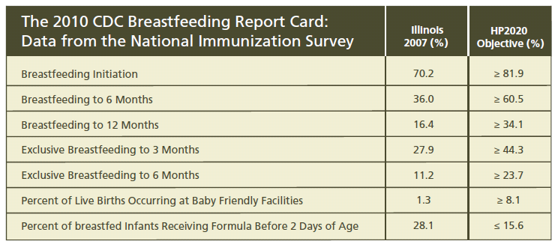
Comparison to a Benchmark

Slide 35
Comparison to a Benchmark
Notes:
The overall prevalence in Missouri was fairly close to the national figure (41.3% vs. 42.6% in 2002), but remained far above the Healthy People 2010 objective of 30% or less.
When stratified by selected maternal characteristics, only women 30 years of age or older, Hispanic or with other race/ethnicity groups, or with private insurance had prevalence of unintended pregnancy below the HP 2010 objective of 30%
34

Slide 36
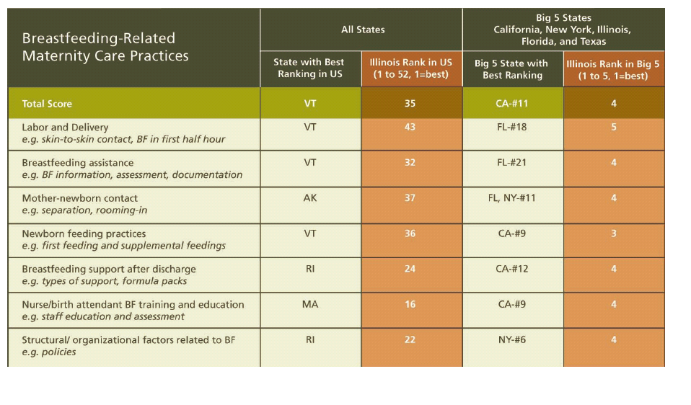
Choosing Appropriate
Comparison Groups

Slide 37
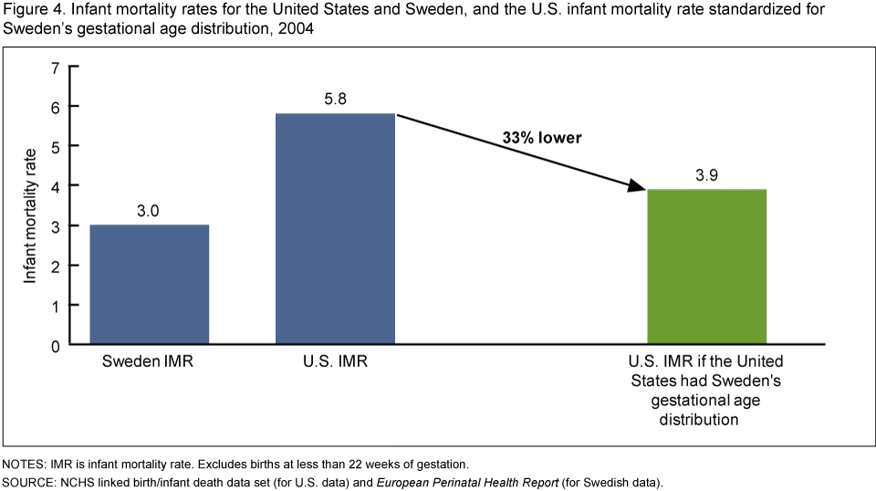
Choosing Appropriate Comparison Groups
Much of the high infant mortality rate in the United States is due to the high percentage of preterm births.
http://www.cdc.gov/nchs/data/databriefs/db23_Fig4.png

Slide 38
Principle 2: Causality, Mechanism, Structure, Explanation
Show causality, mechanism, explanation, systematic structure
    Highlight policies, interventions, risk factors, or changes in human behavior that may have caused a trend or association

Slide 39
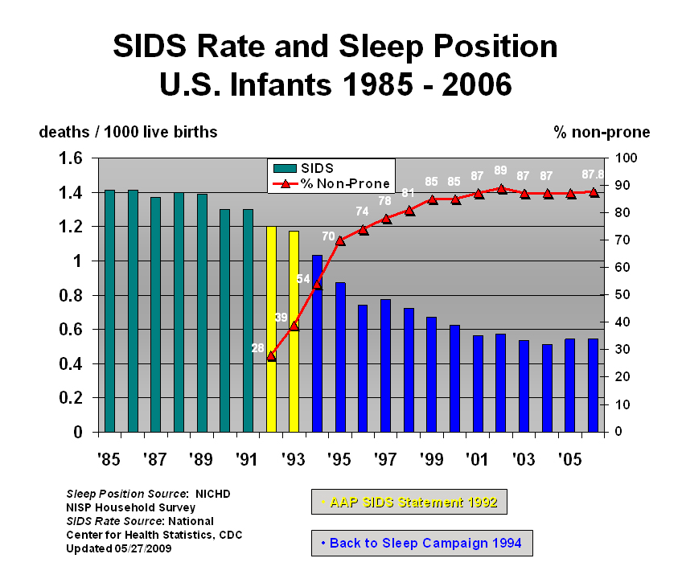
Suggesting Causality
http://emedicine.medscape.com/article/1004238-overview

Slide 40
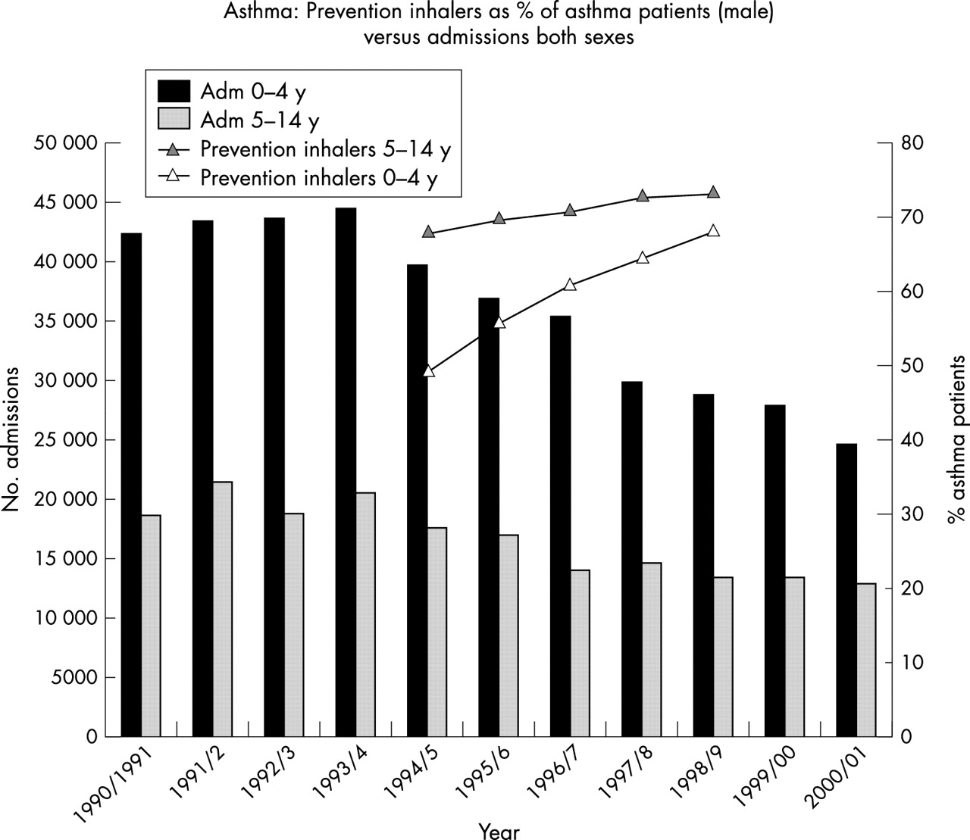
Suggesting Causality
MacFaul (2004). Trends in asthma hospitalization: is this related to
prevention inhaler use? Arch Dis Child 89:1158-1160.

Slide 41
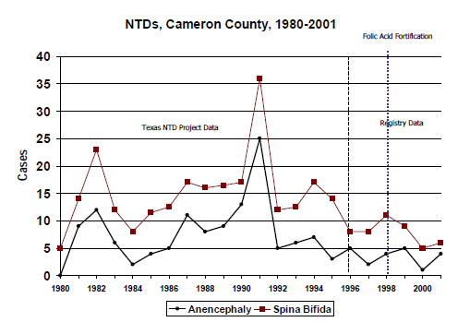

Slide 42
Principle 3: Multivariate Analysis
Show more than 1 or 2 variables
Use stratification to show differences across groups
Use regression modeling when appropriate to capture multivariable nature of problem
Use and communicate adjustment procedures

Slide 43
Multivariable Analysis - Stratification

Slide 44
Presenting Results of Multivariable Models in Charts
  Present a series of adjusted ratio measures (OR, RR, HR, etc) on one chart for comparison
  The scale is different for ratio measures that are less than one (protective factors) versus those that are greater than one
  Include error bars to represent both the precision of the estimate (width of the confidence intervals) and the significance level of the estimate

Slide 45
Individual-Level
Risk Factors for Childhood Obesity
Adjusted* OR (95% CI)
.5
1.5
2.5
3.5
Watches >2 Hrs TV
FL
Watches No TV
US
No Participation in Sports
No Participation in
Clubs-Organizations
Inadequate Exercise
* Adjusted for Socio-Demographic & Community Risk Factors
Data Source: National Survey of Children’s Health, Florida and US 2003/4

Slide 46
Presenting Predicted Values from Multivariable Models in Charts
Estimate predicted probabilities from binomial regression models for groups of women with different risk status
Use beta estimates from model to determine highest/lowest risk value for each variable and write contrast/estimate statement to estimate the predicted probability for each group.

Slide 47
Presenting Predicted Values from Multivariable Models in Charts

Slide 48
Principle 4: Integration of Evidence
Completely integrate words,
numbers, images, diagrams
  Use clear titles, direct labels and footnotes
  Avoid legends as much as possible or put them inside the chart to maximize the chart area and keep the labels closer to the data
  Blend graphical representations of data with short narrative to help with interpretation
  Detail adds precision, clarity and credibility

Slide 49
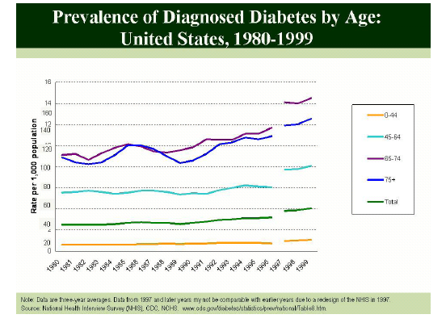
Indirect Labeling

Slide 50
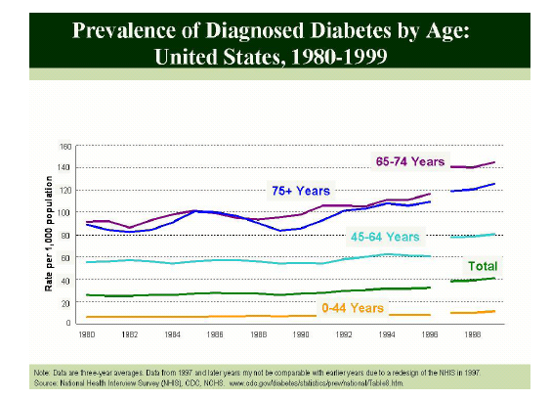
Direct Labeling

Slide 51
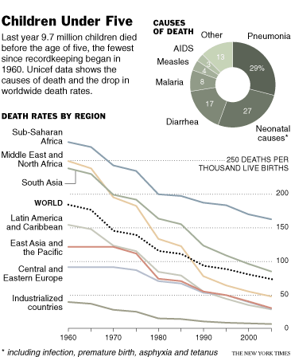
Integration of Evidence
Child Mortality at Record Low; Further Drop Seen
By DONALD G. McNEIL Jr.
Published: September 13, 2007 in the New York Times

Slide 52
Narrating Charts
Narrative inserted directly in charts or in accompanying text helps guide your audience (ie the general public in your jurisdiction, advocates, policy makers) to interpret the charts and can be used to highlight particularly important or meaningful results
Clear titles and labels are still needed in case the reader skips over this additional text

Slide 55
Insurance Status of Illinois Workers by Employment Status, Employer Size, and Residence
The pattern of insurance status for full-time, part-time and unemployed workers is similar across IL, but the rates of uninsuredeness vary by geographic area. Chicago has the highest rates regardless of the employment status of its workers.

Slide 56
Narrating Tables
  Present a series of adjusted ratio measures (OR, RR, HR, etc) in one table for comparison
  Convey reference groups and significance in a way that is clear to a general audience
  Narrate tables when appropriate to help audience interpret results

Slide 57
Tables with Modeling
Results: Some Issues
Narrating Tables
Table 1. Adjusted* Prevalence Ratio (aPR) of factors associated with late or no entry into prenatal care, MA PRAMS, 2007
 | aPR | 95% CI
Age and education
< 20 yrs | 3.3 | 1.8, 6.0**
20+ yrs, ≤high school | 1.5 | 1.0, 2.3**
20+ yrs, > high school | Ref | --
Maternal race
White non-Hispanic | Ref | --
Black non-Hispanic | 1.8 | 1.2, 2.6**
Hispanic | 1.4 | 0.9, 2.1
Other | 1.9 | 1.3, 2.7**
Not married vs. married | 1.1 | 0.7, 1.7
Parity
No previous live birth | Ref | --
1-2 previous live births | 1.2 | 0.9, 1.7
3+ previous live births | 2.6 | 1.6, 4.3**
Pre-pregnancy insurance
Private | Ref | --
Medicaid | 1.7 | 1.1, 2.8**
Uninsured | 1.8 | 1.1, .8**
* Adjusted for all other variables at the same time ** Statistically significant at α=0.05 compared to reference group
      Titling, labeling
      Reference group display, position, wording
      Confidence interval display, format
      Describing statistical results
      Explanatory text in table

Slide 58
Narrating Tables
Table 1. Comparing the percents of Massachusetts women who get into prenatal care late or not at all across various factors, PRAMS, 2007
 | Ratio of Percents | 95% CI
Age and education
< 20 yrs | 3.3 | 1.8, 6.0**
20+ yrs, ≤high school | 1.5 | 1.0, 2.3**
20+ yrs, > high school | Ref | --
Maternal race
White non-Hispanic | Ref | --
Black non-Hispanic | 1.8 | 1.2, 2.6**
Hispanic | 1.4 | 0.9, 2.1
Other | 1.9 | 1.3, 2.7**
Not married vs. married | 1.1 | 0.7, 1.7
Parity
No previous live birth | Ref | --
1-2 previous live births | 1.2 | 0.9, 1.7
3+ previous live births | 2.6 | 1.6, 4.3**
Pre-pregnancy insurance
Private | Ref | --
Medicaid | 1.7 | 1.1, 2.8**
Uninsured | 1.8 | 1.1, .8**
* Accounting for all other characteristics simultaneously. ** Significantly different from the reference group (α=0.05).
Tables with Modeling
Results: Some Issues
        Titling, labeling

Slide 59
Tables with Modeling
Results: Some Issues
Narrating Tables
Table 1. Comparing the percents of Massachusetts women who get into prenatal care late or not at all across various factors, PRAMS, 2007
 | Ratio of Percents | 95% CI
Age and education
< 20 yrs | 3.3 | 1.8-6.0**
20+ yrs, ≤high school | 1.5 | 1.0-2.3**
20+ yrs, > high school | Ref | --
Maternal race
Black non-Hispanic | 1.8 | 1.2-2.6**
Hispanic | 1.4 | 0.9-2.1
Other | 1.9 | 1.3-2.7**
White non-Hispanic | Ref | --
Not married vs. married
Not Married | 1.1 | 0.7-1.7
Married | Ref | --
Parity
3+ previous live births | 2.6 | 1.6-4.3**
1-2 previous live births | 1.2 | 0.9-1.7
No previous live birth | Ref | --
Pre-pregnancy insurance
Medicaid | 1.7 | 1.1-2.8**
Uninsured | 1.8 | 1.1-0.8**
Private | Ref | --
* Accounting for all other characteristics simultaneously. ** Significantly different from the reference group (α=0.05).
        Reference groups all the last category
        Confidence intervals alligned and with hyphens

Slide 60
Tables with Modeling
Results: Some Issues
Narrating Tables
Table 1. Comparing the percents of Massachusetts women who get into prenatal care late or not at all across various factors, PRAMS, 2007
 | Ratio of Percents
Compared to women at least 20 years old with more than than high school
< 20 yrs | 3.3**
20+ yrs & ≤high school | 1.5**
Compared to White, non-Hispanic women
Black non-Hispanic | 1.8**
Hispanic | 1.4
Other | 1.9**
Compared to married women
Not Married | 1.1
Compared to women giving birth for the first time
3+ previous live births | 2.6**
1-2 previous live births | 1.2
Compared to women with private pre-pregnancy insurance
Medicaid | 1.7**
Uninsured | 1.8**
* Accounting for all other characteristics simultaneously. ** Significantly different from the comparison group (α=0.05).
        Reference groups displayed as headers
        Confidence intervals not displayed

Slide 61
Table 1. Comparing the percents of Massachusetts women who get into prenatal care late or not at all across various factors, PRAMS, 2007
Maternal Characteristic | Ratio of Percents |  | Interpretation
< 20 yrs | 3.3** |  | Compared to women at least 20 years old with more than a high school education, adolescents were approximately 3 times more likely, and adult women who did not complete high school were 1.5 times more likely to report late or no prenatal care.
20+ yrs & ≤high school | 1.5**
Black non-Hispanic | 1.8** |  | Compared to white, non-Hispanic women, black, non-Hispanic women were almost 2 times more likely to report late or no prenatal care.
Hispanic | 1.4
Other | 1.9**
Not Married | 1.1 |  | Compared to married women, approximately the same percent of unmarried women said they got late or no prenatal care.
3+ previous live births | 2.6** |  | Compared to women giving birth for the first time, the percent of women who said they got late or no prenatal care was similar for those with 1 or 2 previous births, but was 2.6 times greater for women who had three or more previous births.
1-2 previous live births | 1.2
Medicaid | 1.7** |  | Compared to women with private insurance before they got pregnant, women either on Medicaid or with no health insurance coverage were close to 2 times more likely to say they entered prenatal care late or not at all.
Uninsured | 1.8**
* Accounting for all other characteristics simultaneously. ** Significantly different from the comparison group (α=0.05).

Slide 62
Principle 5: Documentation
Thoroughly describe the evidence; important for establishing credibility
    Provide a detailed title
    Indicate authors and sponsors
    Document data sources and years
    Show complete measurement scales
    Acknowledge error (confidence intervals) in estimates when appropriate
    Communicate statistical significance when appropriate

Slide 63
Measurement Scales
Always start y-axis at zero for bar charts; use points instead of bars if y-axis must start at a number other than zero to zoom in on relevant data
Proportions can be distorted when scales change across or within charts; for example:
  Two different graphs examining the same outcome, but based on different time periods or different lengths of time
  A bar graph of several time-based groups, where the groups correspond to different lengths of time
  Graphs of statistical functions, such as regression lines, that extend beyond the range of values observed in the data
“Guidelines for Conducting Birth Defects Surveillance Chapter 11 - Data Presentation”: http://www.nbdpn.org/docs/Ch11_DataPresentation.pdf

Slide 64
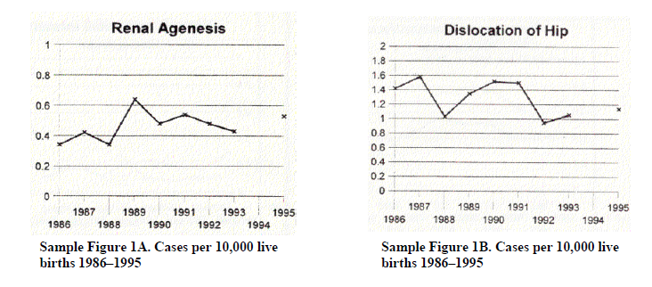
Measurement Scales
Cases per 10,000 live births for select birth defects (Muscatello et al, 2006)
“Guidelines for Conducting Birth Defects Surveillance Chapter 11 - Data Presentation”: http://www.nbdpn.org/docs/Ch11_DataPresentation.pdf

Slide 65
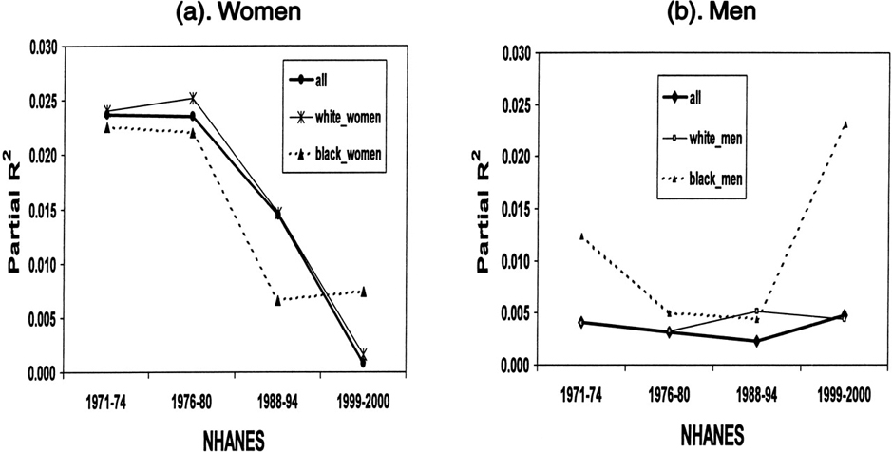
Measurement Scales
Figure 2: Changes in the variation of BMI explained
by SES (partial R²) among U.S. adults: 1971 to 2000.
Zhang Q and Wang Y ( 2204). Trends in the Association between Obesity and Socioeconomic Status in U.S. Adults: 1971 to 2000. Obesity Research 12: 1622-1632.

Slide 66
Confidence Intervals
Source: IL Pregnancy Risk Assessment Monitoring System, 2005

Slide 67
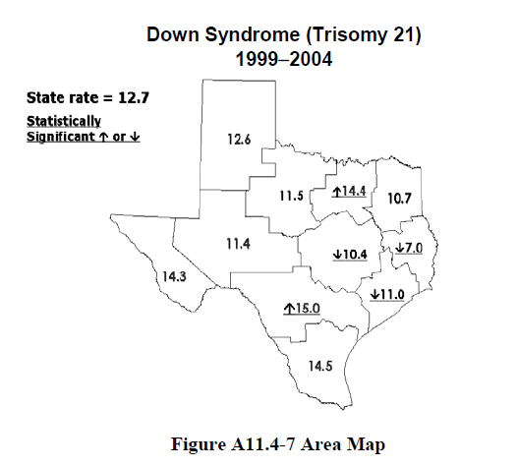
Communicating Statistical Significance

Slide 68
Principle 6: Content Counts
Most of All
Analytical presentations ultimately stand or fall depending on the quality, relevance and integrity of content
Charts/tables should be content focused, not process focused
  Simple design, rich content
  Eliminate anything that doesn’t contribute to content, including boxes, legends, “chart junk”

Slide 69
  Small Multiples
  Minimize the time it takes audience
  to figure out format
  By keeping the quantitative scale consistent, graphic is easier for audience to read
  Audience doesn’t need to figure out format again with each new display of information
  Especially useful when there is a fourth dimension that would make a single chart too busy or difficult to interpret

Slide 70
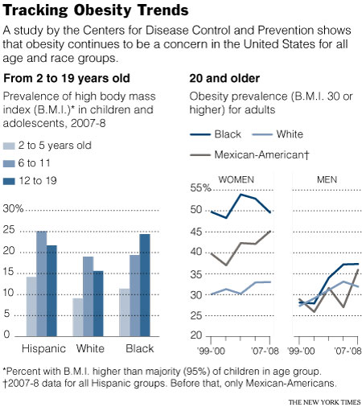
Small Multiples
How many dimensions
are in this chart?
What are they?
From: “Obesity Rates Hit Plateau in U.S., Data Suggest”
By Pam Belluck
New York Times, Published: January 13, 2010

Slide 71
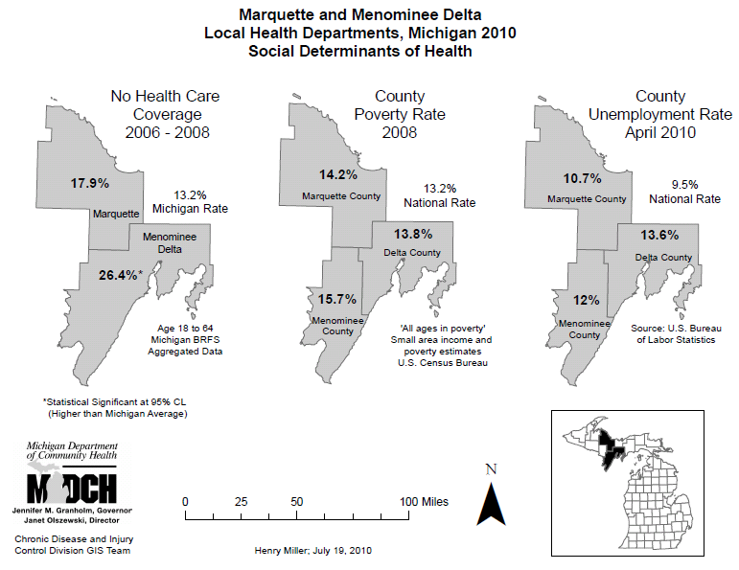
Small Multiples
http://cehi.nicholas.duke.edu/gisexchange/mapgallery/maps/detail/index.html?24#24

Slide 72
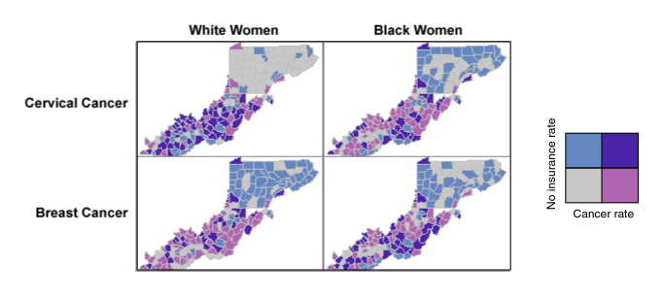
Small Multiples
In this example, we show four (bivariate!) small multiple maps of cancer rates and health insurance. Grey areas are counties with low rates of cancers and low rates of women without insurance (i.e., high rates of women having health insurance). Dark purple areas are counties with high rates of cancer and high rates of women without insurance. Using a small multiple technique for representing this data allows us to further segment the population of women by two additional variables (cancer type and race) to see if there are different spatial patterns of cancer among those segments of the total population.
https://www.e-education.psu.edu/geog486/l8_p5.html
Notes:
In this example, we show four (bivariate!) small multiple maps of cancer rates and health insurance. Grey areas are counties with low rates of cancers and low rates of women without insurance (i.e., high rates of women having health insurance). Dark purple areas are counties with high rates of cancer and high rates of women without insurance. Using a small multiple technique for representing this data allows us to further segment the population of women by two additional variables (cancer type and race) to see if there are different spatial patterns of cancer among those segments of the total population.

Slide 73
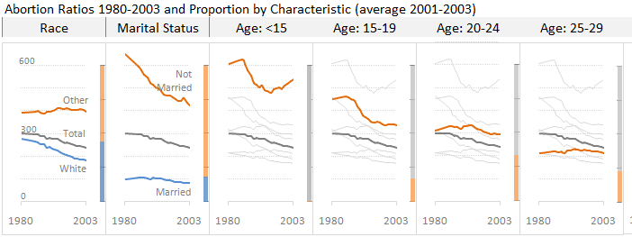
Small Multiples
http://www.excelcharts.com/blog/chart-design-abortion-ratios-1980-2003/
Notes:
. We know that information visualization is all about pattern detection. But often our design choices hide relevant patterns behind the obvious one(s). Take this panel, for instance. Everyone can see the downward pattern, but what about the U-shaped pattern across age groups? You can see it, right? Well, follow the usual path and you’ll miss it.
2. A ratio (or a growth rate) is something that should always be put in the context of actual volumes or proportions. There is no “best answer” to link both dimensions but the panel displays a reasonable solution. As you can see, the abortion ratio among women less than 15 years old is very high but its proportion in the total number ob abortions is almost residual. On the other hand, the ratio in the 15-19 age group may be lower, but it is much higher than the average ratio and accounts for around 17 of the total abortions. Whenever possible, you should keep these two measures close together.
3. There are seven age groups in this data set. Put them all together in a single line chart and you’ll miss the pattern across groups, as discussed above, but you’ll also have a hard time disentangling the whole thing. Before creating the chart always ask: what is my specific question? This will help you to prioritize and create a focus-context display. If a series answers your question (need-to-have) add it to the chart and color-code it. If a series is interesting but doesn’t directly answer your question (nice-to-have), you may add it to the chart to provide context, but gray it out and delete if from the legend, if you have one.

Slide 74
Minimize “Ink-to-Data Ratio”
    Reduce optical clutter
Remove boxes around text, legends and figures
Eliminate gridlines in favor of data labels, or
De-emphasize gridlines with white breaks in bars
Minimize axis labels
Example: Label every other year on x-axis
Remove tick marks for categorical data
In cases where all of the above is
generated by the graphing software by default,
do not hesitate to edit it out wherever possible

Slide 75
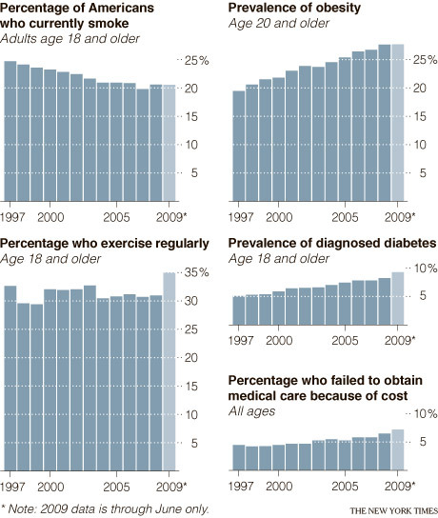
De-emphasizing Gridlines
“Vital Statistics: A Mixed Report on American Health”
By NICHOLAS BAKALAR
New York Times, Jan 25, 2010
Tricking Excel to do this: http://peltiertech.com/Excel/Charts/ArbitraryGridlines.html

Slide 76
Use of Color
  Color should be used only if it conveys additional information
  In general, use soft colors in graphs and reserve bolder, brighter colors for points that you want to stand out
  If color is used to distinguish two different categories, make sure they are different enough in intensity to be distinguished in black and white and for the color blind
  Gradations of one color should only be used with ordered variables, not nominal variables
http://www.perceptualedge.com/articles/Whitepapers/Communicating_Numbers.pdf
http://www.perceptualedge.com/articles/visual_business_intelligence/rules_for_using_color.pdf

Slide 77
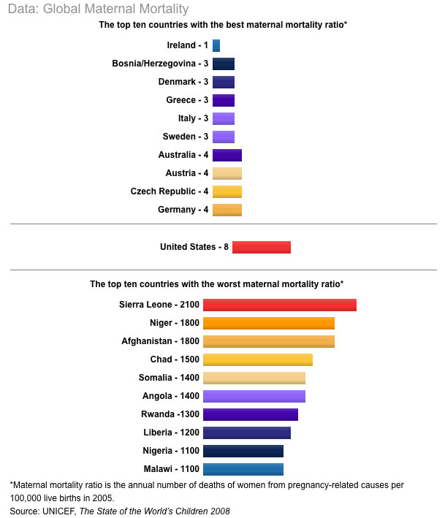
Ineffective Use of Color
http://worldfocus.org/blog/2008/12/02/birth-is-deadly-for-guatemalan-women/3035/

Slide 78
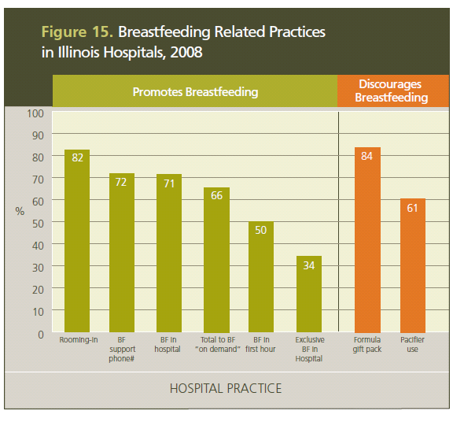
Effective Use of Color
http://www.ilbreastfeedingblueprint.org/

Slide 79
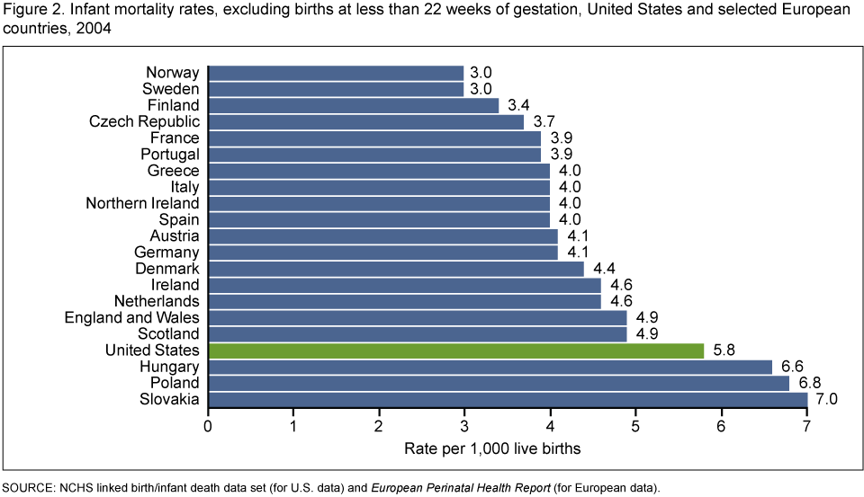
Effective Use of Color
http://www.cdc.gov/nchs/data/databriefs/db23.htm

Slide 80
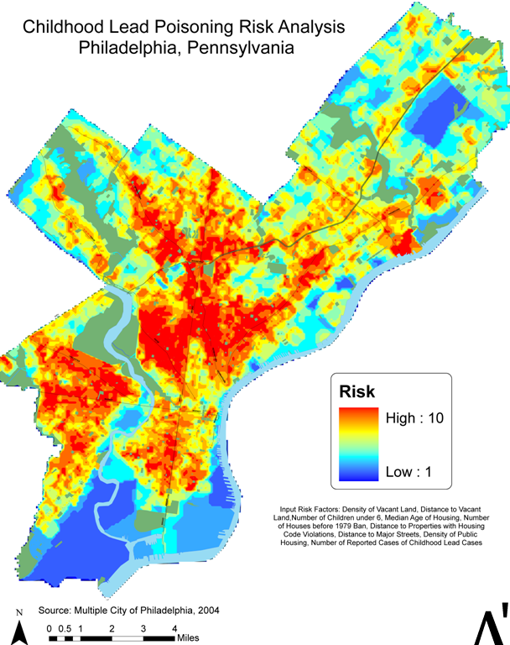
Effective Use of Color
http://www.cdc.gov/gis/mg_lead_poisoning.htm

Slide 81
Minimize Chartjunk
“Chartjunk” = Visual elements in charts that are not necessary to comprehend the information and distract viewer from information
    Background colors or graphics
    Pictures
    Clip art or animations
    3-D effects – distort images
Tufte, Edward R. (1983). The Visual Display of Quantitative Information. Cheshire, CT: Graphics Press.

Slide 82
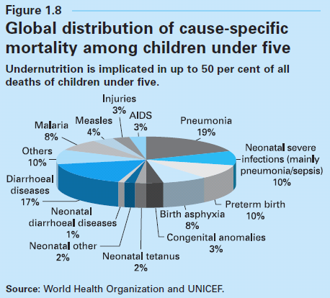
3-D Distortion
http://www.unicef.org/publications/files/The_State_of_the_Worlds_Children_2008.pdf

Slide 83
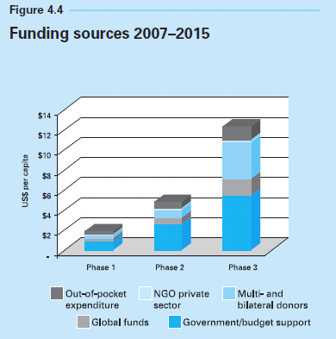
3-D Distortion
http://www.unicef.org/publications/files/The_State_of_the_Worlds_Children_2008.pdf

Slide 84
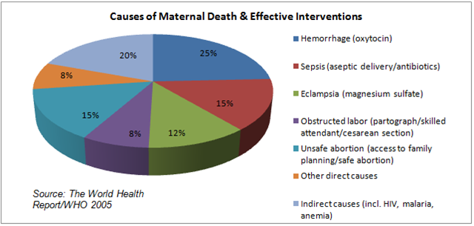
3-D Distortion
http://confutata.com/2010/03/12/safe-birth-is-a-human-rights-issue/

Slide 85
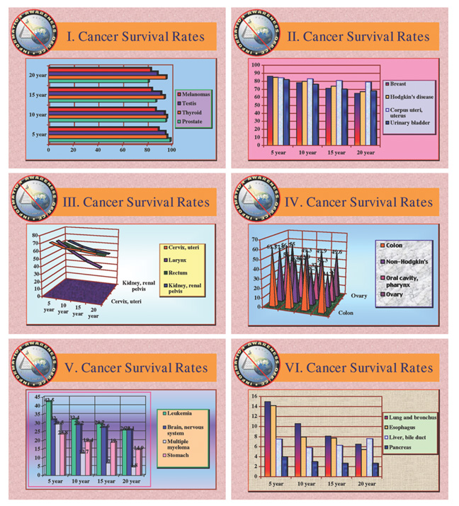
3-D Distortion
http://www.edwardtufte.com/bboard/q-and-a-fetch-msg?msg_id=0000Jr

Slide 86
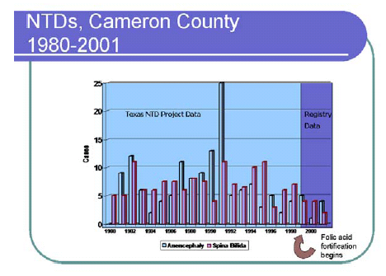
Chartjunk

Slide 87
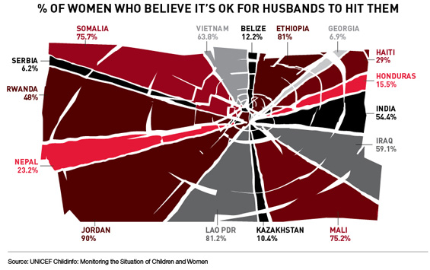
Chartjunk
http://www.globalhealthmagazine.com/screenshots/of_women_who_believe_its_ok_for_husbands_to_hit_them

Slide 88
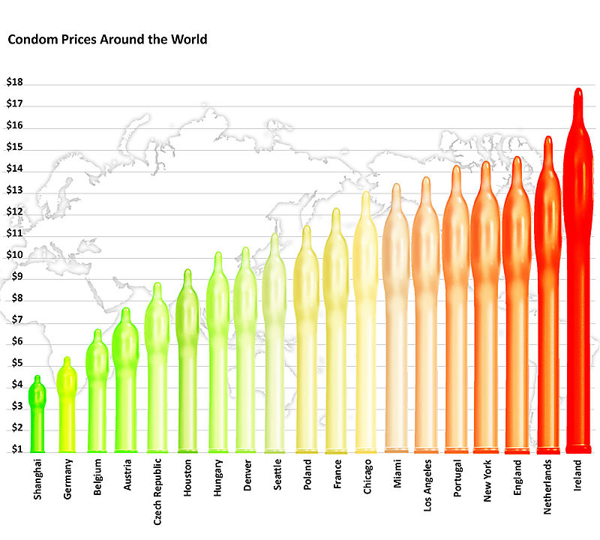
Chartjunk
http://www.presentationzen.com/presentationzen/2008/07/environmental-graffiti-posted-a-bar-chart-suitable-for-entry-into-the-bar-chart-hall-of-shame-i-made-a-list-of-at-least-ten.html
Notes:
How many ways could you improve this chart?
How many ways can you misinterpret the chart's meaning at first glance?
Issues:
signal vs. noise
contrast/affinity,
color,
area distortion,
labeling, etc.
Perhaps a simple table would lead to more clarity (and less snickering).

Slide 89
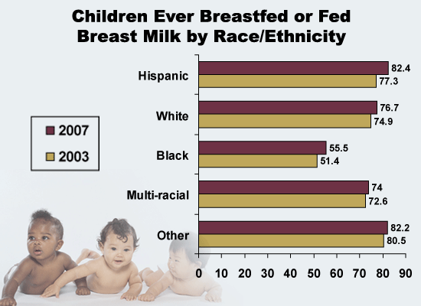
Chartjunk?
http://www.cdc.gov/Features/dsBreastfeedingNSCH/

Slide 90
CLOSING THOUGHTS

Slide 91
Consider Your Audience Means Respect Your Audience
Don’t underestimate audience and “dumb-down” content
Educate as you inform
  Example: if you never show standard errors because your audience doesn’t understand them, your audience will never understand them
Use “plain language”
  A plain language document-one in which people can
    Find what they need
    Understand what they find
    Act appropriately on that understanding
PLAIN LANGUAGE: A PROMISING STRATEGY FOR CLEARLY COMMUNICATING HEALTH INFORMATION AND IMPROVING HEALTH LITERACY
http://www.health.gov/communication/literacy/plainlanguage/PlainLanguage.htm

Slide 92
Consider Your Audience Means Respect Your Audience
Plain language:
Organize information so the most important behavioral or action points come first
Break complex information into understandable chunks
Use simple language or define technical terms
Provide ample white space so pages look easy to read
Use short sentences and active voice
“Plain language is not “dumbing down”…
  “Plain language is not just about vocabulary or grade level. Writing to a certain grade level does not necessarily ensure that the message is in plain language or understood by the intended audience…”
PLAIN LANGUAGE: A PROMISING STRATEGY FOR CLEARLY COMMUNICATING HEALTH INFORMATION AND IMPROVING HEALTH LITERACY
http://www.health.gov/communication/literacy/plainlanguage/PlainLanguage.htm

Slide 93
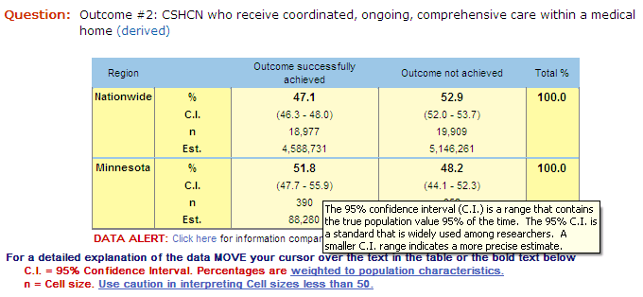
Educate as you Inform
Explaining Confidence Intervals
http://www.cshcndata.org/DataQuery/DataQueryResults.aspx

Slide 94
Educate as You Inform: Explaining Adjustment
To more accurately portray relationships between risk factors and health outcomes, we use a statistical approach called “adjustment” to account for characteristics that might distort what we see
  Example: We adjust for a woman’s age and educational level to better understand the relationship between cigarette smoking and infant mortality
The information about relationships between risk factors and MCH is reported using adjustment. This approach accounts for differences among women that might distort what we see.
  Example: The relationship between cigarette smoking and infant mortality might be distorted unless we adjust for the differences in women’s age and educational level
The statistics reported are adjusted so that they account for differences between women. With this approach, the comparisons we report, for example between those with and without health insurance, are accurate regardless of other factors

Slide 95
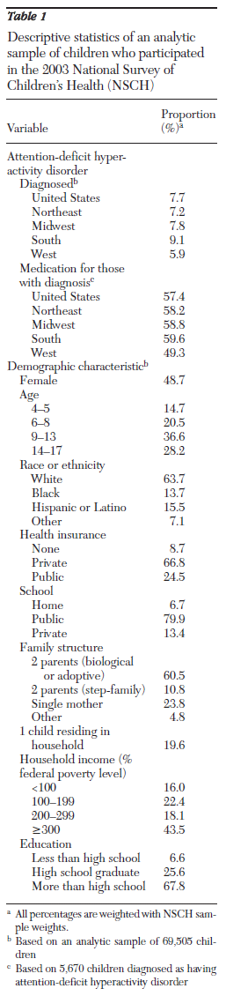
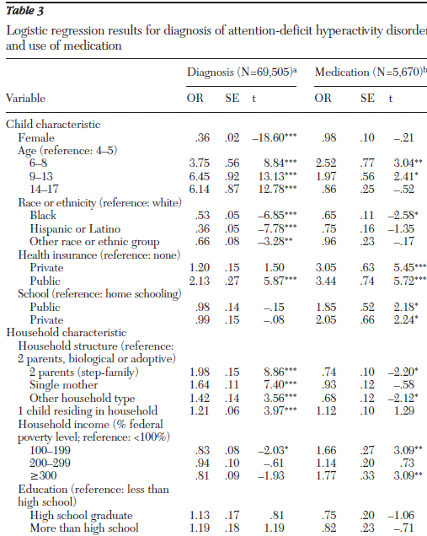
Educate as you Inform
Fulton, et al 2009, Psychiatric Services, NSCH (2003) analysis:
From the Results Section:
“To aid interpretation [of Table 3], we translated the odds ratios into probabilities using a boy and girl between age nine
and 13 with the most common characteristics
in the sample (see Table 1). The predicted diagnostic prevalence
for the boy and girl for the United States was 10.7% and 4.1%, respectively…”

Slide 96
Balancing Clarity and Detail
Consider a layered approach to presenting results in order to allow audience to drill down from summary points to details:
  Executive Summary
  Detailed graphs and charts with annotation and accompanying narrative/pictures
  Appendix with all underlying tables and statistical results, as well as methods and data source description
Prior to finalizing reports, always pilot materials with a few people who are unfamiliar with the data to make sure your message is getting across as anticipated; Revise as necessary

Slide 97
Take-Home Message
Analytic methods need not be simplistic in order to deliver a clear, simple message and scientific rigor should be practiced regardless of the audience

